Slide 1

Economics of Living Independently
Living on a Budget
Cost of Living
Insurance

Slide 2

Living on a Budget
Track income
Discretionary spending
Savings
Fixed spending

Slide 3
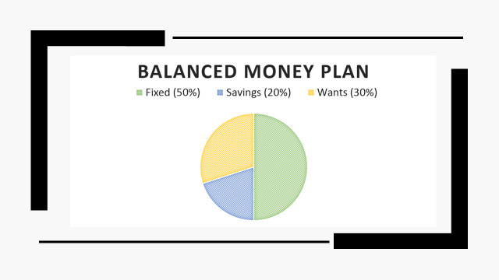

Slide 4


Insurance
Auto
Health/Dentil
Life
House

Slide 5

Insurance Terminology
Deductible
Claim
coinsurance
Annuity
Policy
premium

Slide 6

Auto
Liability coverage
Bodily injury coverage
Property damage liability
Deductible
Why do people not like to use
Insurance often?

Slide 7
Health Insurance
Staying on Parent’s insurance
-qualifications
COBRA
Deductible (in terms of health insurance)
Company Insurance
Health Savings Account

Slide 8
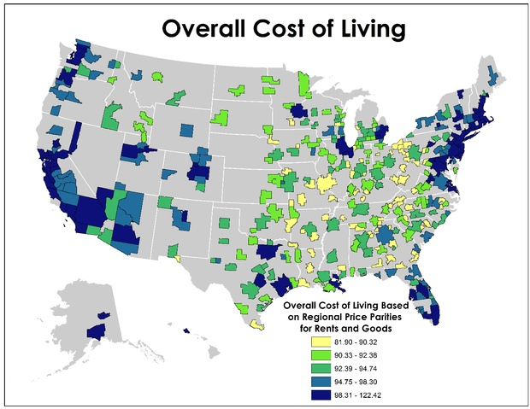
Cost of Living in Different Regions
California vs Washington vs New York

Slide 9

Housing
Benefits of renting
Benefits of owning a house/condo
Applying for a loan for big item expenses/
investments

Slide 10

Managing Food Costs
Learn to cook
Store brands
Coupons
Buy in bulk
Dining out

Slide 11

Cutting Transportation Costs
Public Transportation
Alternate Routes
Leasing vs owning

Slide 12

Keeping Down Insurance Costs
Deductibles
Broad Coverage
Shop Around
Overall Wellness

Slide 13

Dealing with Unemployment
Applying for unemployment
Tax deductibles for search
Decreasing spending
Insurance

